Slide 1
Blockchain-Based Supply Chain Analytics and Vendor Performance Intelligence System
ACADEMIC PROJECT · BLOCKCHAIN
MEMBER 1
MEMBER 2
MEMBER 3
K. Ashwitha
A. Tejasri
S. Rohith
2303A52216
2303A52455
2303A52262
Batch - 45
Batch - 31
Batch - 43
CSE (AIML) · 4th Year · SR UNIVERSITY
Notes:
Good morning everyone. We are the project team: K. Ashwitha, A. Tejasri and S. Rohith, from CSE (AIML), 4th year, SR University. Our project is the Blockchain-Based Supply Chain Analytics and Vendor Performance Intelligence System. In one line: it stores supply chain shipment records in a blockchain, lets us simulate tampering, validates the chain to catch it, and uses the trusted data to score vendors. It is built in Python with a Tkinter graphical interface.

Slide 2
Introduction
The problem
The idea
This project
A supply chain is the network of vendors, factories, warehouses and carriers that moves goods to the customer. Its records sit in central databases, where a delivery date or a defect count can be edited without a trace. Trust then depends on whoever keeps the records.
A blockchain is an append-only list of blocks. Each block stores data, a timestamp and the hash of the previous block. Changing one block changes its hash and breaks every link after it, so tampering becomes visible instead of silent.
We store shipment records in such a chain, let the user simulate tampering, and validate the chain to detect it. Because the data is verifiable, we then compute vendor performance (on-time delivery, defect rate and a score) from it.
Blockchain-Based Supply Chain Analytics
Notes:
Start with the problem: in a normal database, a record can be changed quietly, so trust depends on whoever controls it. A blockchain fixes this by chaining blocks together with cryptographic hashes. If someone edits one block, its hash no longer matches, and the link to the next block breaks. Our project applies this idea to supply chain shipment records, and then uses those trusted records to judge how well each vendor performs.

Slide 3
Abstract
This project builds a Python and Tkinter application that records supply chain shipments on a blockchain. Ten shipment records are stored as hash-linked blocks. The user can tamper with any block, run validation to catch the change, and inspect the full chain. Vendor performance is then computed from the chain data, so decisions rest on records that can be verified.
SHA-256 hashing
Proof of work
Tamper detection
Vendor scoring
Blockchain-Based Supply Chain Analytics
Notes:
Read the abstract slowly. Key points: ten shipment records, stored as hash-linked blocks; tampering can be simulated and then detected by validation; and vendor performance (on-time delivery, defect rate, overall score) is calculated from the chain so it can be trusted. The four tags at the bottom are the main technical ideas.

Slide 4
Stakeholders
A stakeholder is any person or group affected by the system or relying on its data. In a supply chain these groups depend on the same shipment records, so a shared, tamper-evident record reduces disputes between them.
Stakeholder | Role in the supply chain | What they gain from the system
Vendors | Supply raw materials and components | A fair, verifiable record of their delivery and quality
Procurement team | Selects vendors and places orders | Data to compare vendors and choose reliable ones
Logistics and warehouse | Moves, receives and stores goods | Shipment records they can trust and trace
Quality control | Inspects goods and counts defects | Defect counts that cannot be edited quietly
Management and auditors | Oversee cost, risk and compliance | A tamper-evident history and vendor scores to review
Blockchain-Based Supply Chain Analytics
Notes:
A stakeholder is anyone who is affected by the system or relies on its data. Five groups care about this one. Vendors want a fair record of how they performed. The procurement team uses the scores to pick vendors. Logistics and warehouse staff rely on trustworthy shipment records. Quality control needs defect counts that cannot be changed without detection. Management and auditors get a tamper-evident history they can review.

Slide 5
Concepts Used
Blockchain
SHA-256 hashing
Proof of work
A chain of blocks in which each block stores the hash of the previous block, making the ledger append-only and tamper-evident.
A one-way function that turns any data into a fixed 64-character code. Changing even one character changes the whole hash.
Mining repeats a nonce until the hash starts with a set number of zeros. Here the difficulty is 3, which makes block creation costly and rewriting expensive.
Validation
Vendor KPIs
Tkinter GUI
Validation recomputes each hash and checks the previous-hash link. Any mismatch shows exactly which block was altered.
On-time delivery %, defect rate % and an overall score turn raw shipment data into a measure of vendor reliability and quality.
Python's standard GUI library. We use a Notebook with three tabs, a Treeview for tables and a Canvas for the bar chart.
Blockchain-Based Supply Chain Analytics
Notes:
Six concepts are used. Blockchain: blocks linked by hashes. SHA-256: a one-way hash function, so any change to the data produces a completely different hash. Proof of work: mining a block means finding a nonce that gives a hash with leading zeros; our difficulty is three zeros. Validation: recompute every hash and compare every link. Vendor KPIs: on-time percentage, defect percentage and a combined score. Tkinter: the standard Python library for the graphical interface, using tabs, tables and a canvas chart.

Slide 6
Our Solution
We built a desktop application that combines a blockchain ledger with vendor analytics. Shipment data is written once into hash-linked blocks, verified on demand, and only then used to score vendors.
Challenge | How our system solves it
Records can be edited silently | Each shipment is a block whose hash covers every field, so any edit is detectable
No proof of where tampering happened | Validation recomputes hashes and links, and names the broken block
Vendor scores built on unverified data | Analytics read from the chain and warn when its data was altered
Hard to review the record history | A Tkinter blockchain view shows every block with its full data
Blockchain-Based Supply Chain Analytics
Notes:
This slide maps each problem to what our system does. Because each block's hash covers all its fields, editing any field is detectable. Validation does not just say the chain is broken, it names the block. The analytics tab reads from the chain, and shows a warning if the data has been changed. Finally, the blockchain view lets anyone review every record and its hashes in the interface.

Slide 7
How the System Works
01
02
03
04
Input
Mine
Validate
Analyse
Ten shipment records are typed into the code as manual inputs. Each has a shipment id, vendor, product, quantity, unit price, promised and actual delivery days, defects and location.
Each record becomes a block. Mining increases a number called the nonce until the SHA-256 hash of the block starts with three zeros. This is the proof of work.
Every block is checked three ways: its hash is recomputed, its previous-hash link is compared with the block before, and its leading zeros are confirmed.
Vendor KPIs are computed from the chain: on-time delivery %, defect %, delay days, total spend, and a score out of 100 with a rating.
Block = index | timestamp | data | previous hash | nonce | hash
Blockchain-Based Supply Chain Analytics
Notes:
Walk through the four steps. One: the ten records are typed into the program. Two: each record is put into a block, and mining repeats a counter called the nonce until the block's SHA-256 hash starts with three zeros. That is our proof of work. Three: validation re-checks every block three ways. It recomputes the hash, compares the previous-hash link, and confirms the leading zeros. Four: vendor performance numbers are calculated from the chain data. The dark bar shows what each block stores.

Slide 8

System Architecture
Presentation layer (Tkinter): what the user sees and clicks
Blockchain View
Tamper and Validate
Vendor Analytics
Block table and details
Edit a block, run checks
KPI table and bar chart
Logic layer (Python): classes and functions that do the work
Block
Blockchain
vendor_analytics()
compute_hash(), mine()
add_block(), validate()
On-time %, defect %, score
Data layer: the inputs and the stored chain
MANUAL_INPUTS
hashlib SHA-256
In-memory chain
The 10 shipment records
Fingerprint of each block
List of mined blocks
Blockchain-Based Supply Chain Analytics
Notes:
The system has three layers. At the top is the presentation layer built with Tkinter: three tabs for viewing the chain, tampering and validating, and vendor analytics. In the middle is the logic layer: the Block class computes hashes and mines, the Blockchain class adds blocks and validates, and a function computes vendor analytics. At the bottom is the data layer: the ten manual inputs, the SHA-256 function from Python's hashlib, and the chain itself, which is a list held in memory. The GUI calls the logic layer, and the logic layer reads and writes the data layer; results flow back up to the screen.

Slide 9



Flowchart
1 · Start
2 · Create block
3 · Mine block
4 · Add to chain
Load the 10 manual inputs
One block for each shipment record
Find a nonce so the hash starts with 000
Link it to the previous block's hash
8 · Result
7 · Decision
6 · Validate
5 · Tamper
Yes: chain valid, show analytics. No: flag the broken block
Do all hashes and links match?
Recompute hashes, compare links
Optional: edit a field in any block
A flowchart shows the order of steps and decisions in a program. The only decision here is validation: if every recomputed hash and link matches, the chain is valid; otherwise the first broken block is reported. Row 2 is read from right to left.
Blockchain-Based Supply Chain Analytics
Notes:
Follow the arrows. Row one builds the chain: load the ten inputs, create a block for each, mine it by searching for a nonce until the hash starts with three zeros, and add it to the chain. Then the second row, read from right to left: optionally tamper with a block, validate the chain, and reach the decision. If all hashes and links match, the chain is valid and the analytics are shown. If not, the broken block is flagged in red.

Slide 10
The 10 Manual Inputs
Each row is one shipment and becomes one block. A delivery is on time when actual days do not exceed promised days. Defects are the faulty units received in that shipment.
Shipment | Vendor | Product | Qty | Unit price | Promised days | Actual days | Defects
SH-1001 | Alpha Traders | Steel Rods | 500 | 42.00 | 5 | 5 | 4
SH-1002 | Beta Supplies | Copper Wire | 300 | 88.50 | 7 | 9 | 12
SH-1003 | Gamma Logistics | Plastic Pellets | 1000 | 15.20 | 4 | 4 | 6
SH-1004 | Alpha Traders | Aluminium Sheets | 250 | 120.00 | 6 | 7 | 3
SH-1005 | Delta Components | Circuit Boards | 150 | 310.00 | 10 | 10 | 2
SH-1006 | Beta Supplies | Rubber Seals | 800 | 6.75 | 3 | 6 | 40
SH-1007 | Gamma Logistics | Packaging Boxes | 2000 | 3.40 | 2 | 3 | 25
SH-1008 | Delta Components | Sensors | 400 | 55.00 | 8 | 8 | 5
SH-1009 | Alpha Traders | Bolts and Nuts | 3000 | 1.80 | 3 | 3 | 9
SH-1010 | Beta Supplies | Cables | 600 | 22.00 | 5 | 5 | 18
Blockchain-Based Supply Chain Analytics
Notes:
These are the only ten manual inputs the project uses. Each row is one shipment and becomes one block. Four vendors appear: Alpha Traders, Beta Supplies, Gamma Logistics and Delta Components. Promised days versus actual days tells us whether a delivery was on time, and defects count the faulty units received. Beta Supplies has the late deliveries and the highest defect counts, which is why it ranks lowest later.

Slide 11
Important Code Snippets
def compute_hash(self):
def validate(self):
payload = json.dumps({
problems = []
"index": self.index,
for i, blk in enumerate(self.chain):
"timestamp": self.timestamp,
if blk.hash != blk.compute_hash():
"data": self.data,
problems.append(
"previous_hash": self.previous_hash,
(blk.index, "Hash mismatch"))
"nonce": self.nonce}, sort_keys=True)
if i > 0 and (blk.previous_hash
return hashlib.sha256(
!= self.chain[i - 1].hash):
payload.encode()).hexdigest()
problems.append(
def mine(self, difficulty):
(blk.index, "Broken link"))
target = "0" * difficulty
return len(problems) == 0, problems
while not self.hash.startswith(target):
self.nonce += 1
Validation (shortened). Each stored hash is recomputed, and each previous-hash link is compared with the block before it.
self.hash = self.compute_hash()
Hashing and mining. The hash covers every field. Mining adds 1 to the nonce until the hash starts with 000.
Blockchain-Based Supply Chain Analytics
Notes:
Two functions carry the whole idea. On the left, compute_hash turns the block's fields into JSON text and runs SHA-256 over it, so a change to any field changes the hash. The mine function keeps adding 1 to the nonce until the hash starts with three zeros, which is the proof of work. On the right, validate loops over every block. It flags a block if its stored hash differs from the recomputed hash, or if its previous-hash does not match the block before it. The full program also checks the leading zeros; this version is shortened to fit the slide.

Slide 12
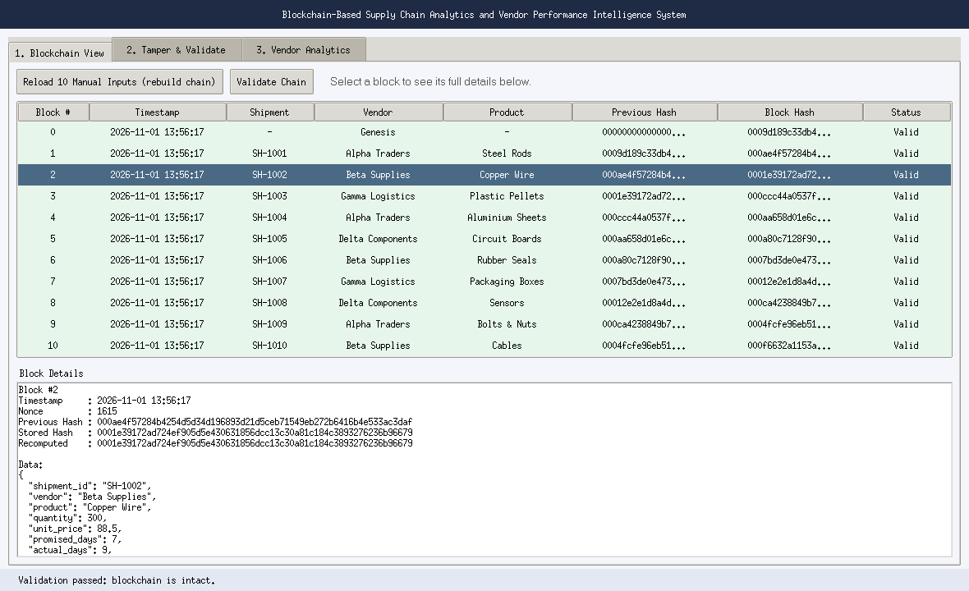
Output 1: Blockchain View
What it shows
Each row is one block. The previous-hash column repeats the block hash from the row above, and that link turns separate records into a chain. Proof of work makes every hash begin with 000.
11 blocks: genesis plus 10 shipments
Green means valid, red means invalid
Click a block for its full data and nonce
Blockchain-Based Supply Chain Analytics
Notes:
This is the first tab of the application. The table lists every block with its timestamp, shipment id, vendor, product, previous hash and its own hash. Green rows mean the block is valid. Point out that the previous-hash column of each row matches the block-hash column of the row above, and that every hash begins with three zeros. Clicking a row shows the full block details underneath.

Slide 13
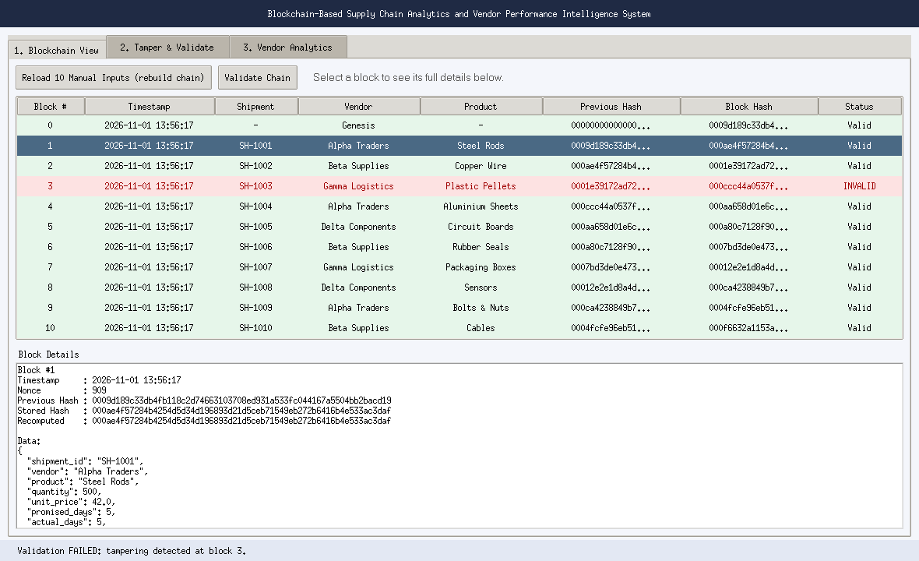
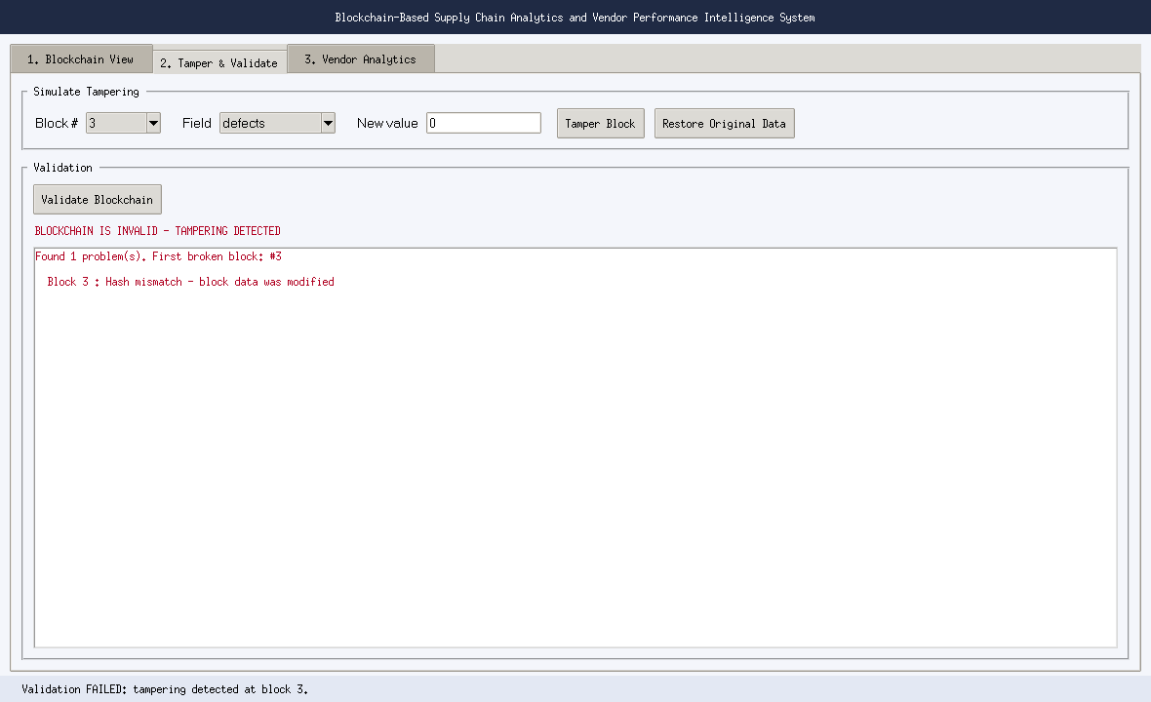
Output 2: Tampering Detected
Chain view: block 3 marked INVALID
Validation names the broken block
Block 3 was edited (defects 6 to 0), so its stored hash no longer matches its data.
The recomputed hash differs from the stored one, so the block is reported as modified.
Blockchain-Based Supply Chain Analytics
Notes:
Here we simulated tampering. On the Tamper and Validate tab we changed the defects field of block 3 (Gamma Logistics, SH-1003) from 6 to 0, as if someone wanted to hide quality problems. The block's data changed but its stored hash did not, so when we press Validate the recomputed hash no longer matches. The result says the blockchain is invalid and that block 3 has a hash mismatch. On the left, block 3 turns red in the chain view. Pressing Restore Original Data brings the chain back to valid.

Slide 14
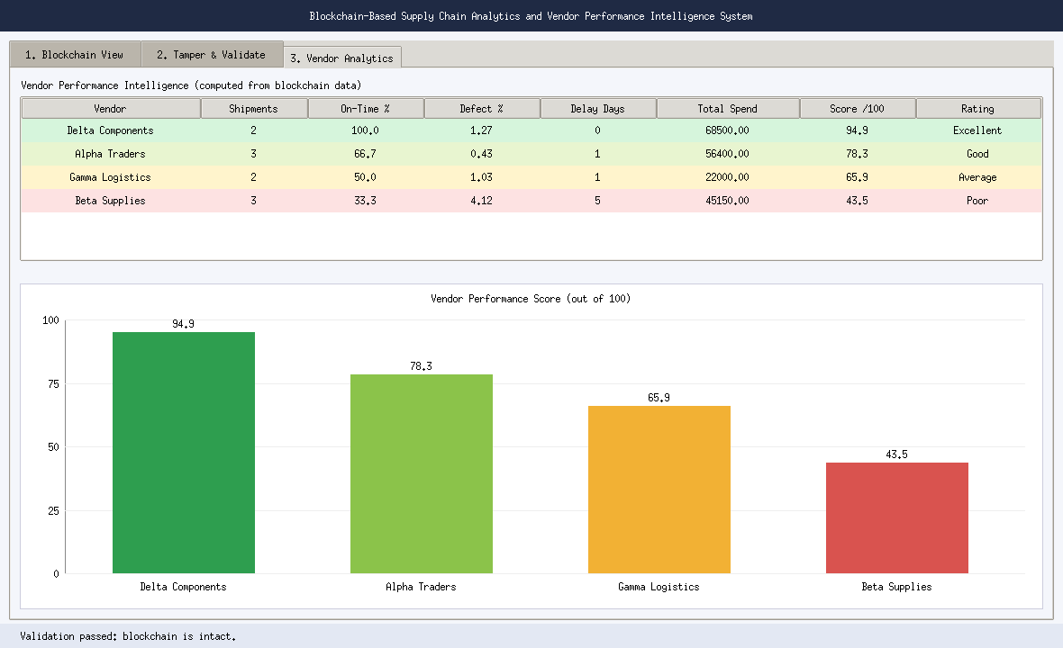
Output 3: Vendor Analytics
Score formula
Score = 0.6 × on-time % + 0.4 × (100 − 10 × defect %). Delivery reliability counts slightly more than quality.
Excellent: 85 and above
Good: 70 to 84
Average: 50 to 69
Poor: below 50
Example: Alpha Traders is 66.7% on time with 0.43% defects, so it scores 78.3 (Good).
Blockchain-Based Supply Chain Analytics
Notes:
The third tab turns the verified chain data into vendor intelligence. For each vendor we compute the share of on-time deliveries, the defect percentage, total delay days and total spend, then combine them into one score out of 100: 60 percent delivery reliability plus 40 percent quality. Results: Delta Components 94.9 (Excellent), Alpha Traders 78.3 (Good), Gamma Logistics 65.9 (Average) and Beta Supplies 43.5 (Poor). If the chain is tampered with, a red warning appears here because the scores would then rest on altered data. The weights are our own design choice and can be changed in the code.

Slide 15
Conclusion
Stored
Protected
Useful
10 shipment records saved as 11 hash-linked blocks, genesis included.
Editing block 3 broke its hash, and validation flagged it at once.
Vendors ranked from Delta Components (94.9) down to Beta Supplies (43.5).
A blockchain makes supply chain records tamper-evident, so vendor decisions can rest on trusted data.
Future scope: multi-node network, database storage and digital signatures.
Blockchain-Based Supply Chain Analytics
Notes:
Wrap up in three points. We stored ten shipment records as eleven hash-linked blocks. We showed that editing one block breaks its hash and that validation catches it. And we used the verified data to rank vendors, with Delta Components best at 94.9 and Beta Supplies lowest at 43.5. Overall, a blockchain makes records tamper-evident, so decisions about vendors can rely on trusted data. Mention the future scope: a multi-node network, saving to a database and digital signatures, which address the limitations on the previous slide.

Slide 16
References
S. Nakamoto, “Bitcoin: A Peer-to-Peer Electronic Cash System,” 2008. https://bitcoin.org/bitcoin.pdf
S. Saberi, M. Kouhizadeh, J. Sarkis, and L. Shen, “Blockchain technology and its relationships to sustainable supply chain management,” International Journal of Production Research, vol. 57, no. 7, pp. 2117–2135, 2019.
S. S. Kamble, A. Gunasekaran, and H. Arha, “Understanding the Blockchain technology adoption in supply chains: Indian context,” International Journal of Production Research, vol. 57, no. 7, pp. 2009–2033, 2019.
National Institute of Standards and Technology, “Secure Hash Standard (SHS),” FIPS PUB 180-4, 2015.
Python Software Foundation, “tkinter: Python interface to Tcl/Tk” and “hashlib: Secure hashes and message digests,” Python 3 Documentation. https://docs.python.org/3/
Blockchain-Based Supply Chain Analytics
Notes:
Thank you. The references cover the original blockchain paper, two journal articles on blockchain in supply chains, the NIST standard that defines SHA-256, and the Python documentation for the libraries used. Invite questions.

